Slide 1
AUTOMATIC BRAKING & HEADLIGHT SYSYEM
BY: TECH NERDS

Slide 2
OUR PROJECT
The base idea behind making our Automatic Braking & headlight System is to inculcate an efficient and life sustaining hardware in order to solve the problems causing vehicle accidents worldwide.

Slide 3
OUR PROCESS
OBJECTIVE 02
OBJECTIVE 01
OBJECTIVE 03
Understanding the cause
Solving the problem
Finding the ways

Slide 4
TABLE OF CONTENTS
01
02
03
Defining & Solving
the problem
Finding Ways
Implementation of solution

Slide 5
01
Defining & solving the problem

Slide 6
UNDERSTANDING THE PROBLEM
MANUAL BRAKING
AUTOMATIC BRAKING
We have brakes that have no power assistance to the pedal, which we call manual brakes.
It is an advanced system, specifically designed to either prevent possible collision, or reduce speed of the moving vehicle, prior to a collision with another vehicle, pedestrian or an obstacle of some sort.

Slide 7
ANALYSIS
Deaths over the world
Major Causes
30%
80%
50%
Drink & drive
Poor visibility
Manual
brakes

Slide 8
TARGET
AGE
18-35 yrs
80%
35-60
50%
75% Automatic brakes
500,000+
Lives can be saved
60% High Intensity Headlight

Slide 9
1,280,000,000
Total number of deaths all over the world due to accidents

Slide 10
—George Santayans
“There is cure for birth and death save to enjoy the interval.”

Slide 11
TESTIMONIALS
— Shivesh Gupta
— Anurag Singh
— Md Javed Ansari
— Ankur Pandey
— Annapurna Mishra
“Proposed the main idea of this project”
“Done all funding of this project”
“Writing research paper ”
“One who brought all hardware”
“Who did all the graphical representation”

Slide 12
FINDING WAYS
02

Slide 13
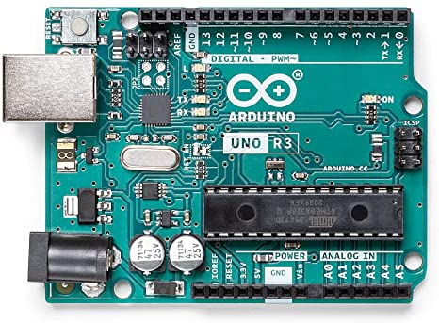
ARDUINO
Bigs and Brains of this project

Slide 14
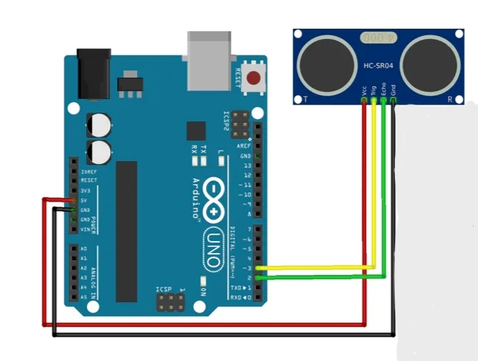
HC-SR04
Ultrasonic Sensor for Distance Measuring
HC-SR04 implemented with ARDUINO

Slide 15
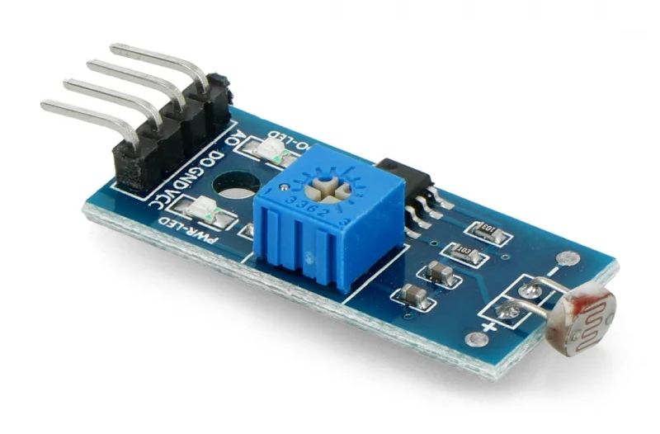
LDR
For light detection and automatic headlights

Slide 16
IMPLEMENTATION OF SOLUTION
03

Slide 17
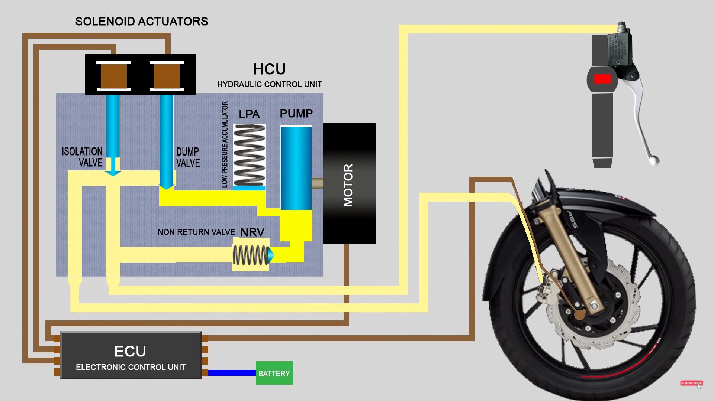
ECU
Electronic Control Unit of vehicle to control all components
In today’s vehicles there is a system called ABS (Anti-Lock Braking System) which prevents tyre locking which causes skidding in vehicles.
Our whole circuitry will be implemented with ECU which controls whole vehicle’s BRAKING SYSTEM and HEADLIGHTS.
As of ABS & Braking System in vehicles, it is completely hydraulic based which will help our ULTRASONIC SENSOR to apply brakes in time.
Now for Headlights these are simple switch based mechanism which can be handled by LDR very easily.
Where ARDUINO will be integrated

Slide 18
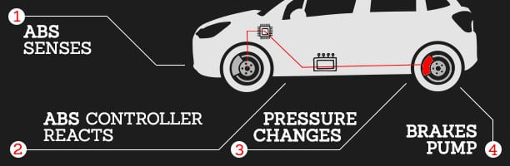
Implementation with ABS
ABS works by releasing and then reapplying or 'pumping' the brakes to a motorcycle wheel or car wheels in heavy braking situations. What we will do?
We will clearly implement our model to ECU which will receive the signal from Arduino sent by ultrasonic sensor causing ABS to apply brakes to prevent the over closeness of vehicles, & finally avoiding the accident.

Slide 19
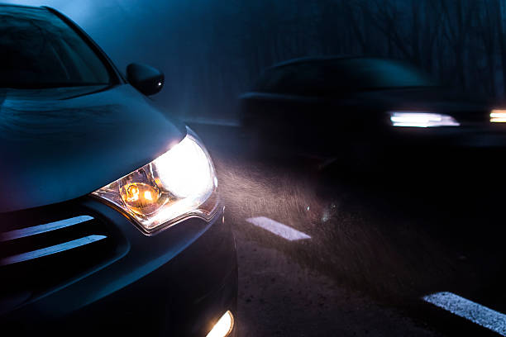
Implementation with Headlights
As we all know, headlights are a crucial asset to a vehicle, preventing bumps & potholes on the road and collisions with other vehicles at night. But if it isn’t switched on in time, it can cause inconvenience.
To remove this factor of improper timing we have implemented LDR(Light Dependent Resistor) which will help in the automation of headlights, as soon as dawn falls LDR will detect the light outside and will send a signal to Arduino to send a signal to ECU to switch on the headlights automatically.

Slide 20
OUR SOLUTIONS
Time Efficient
Economic
Life sustaining
Autonomous driving
ABHS is having better braking system so it is efficient
It can be easily accessible as can be available at cheaper cost.
Reduces road casualties and increases sensing range.
It enhances the quality of driving (brakes and headlights).

Slide 21
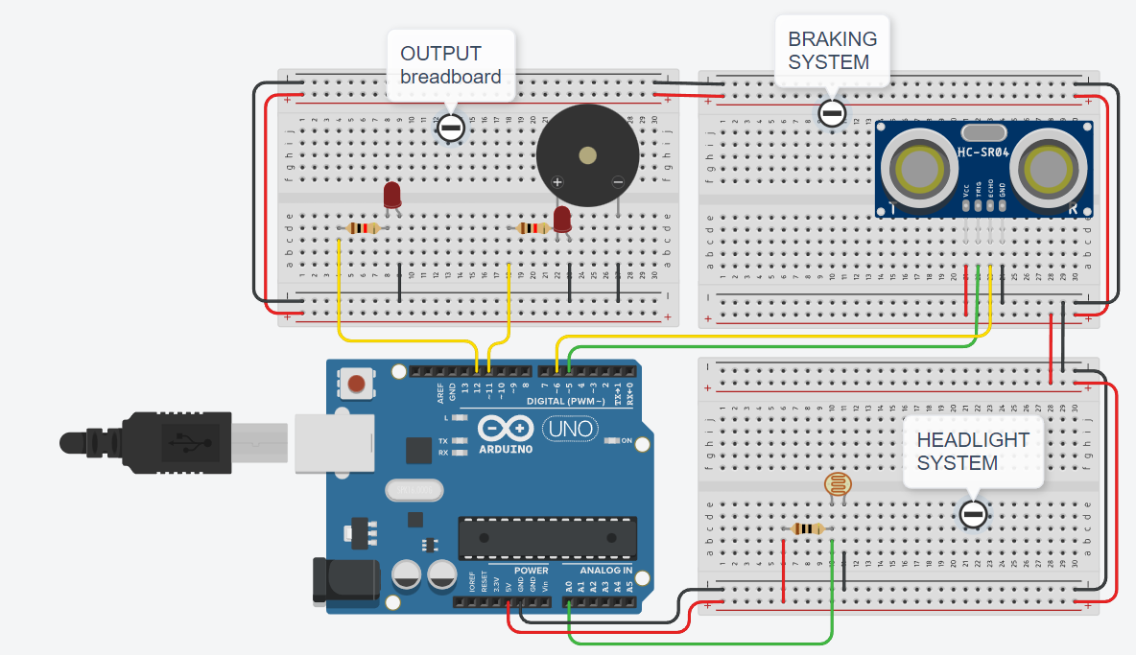
SNEAK PEEK

Slide 22
THANKS
Do you have any questions?
shiveshgupta2003@gmail.com
+91 8875961933

